Slide 1


Why Learn Spanish?
Srta. Marcella
2018-2019

Slide 2
So, you’re in a Spanish class…
*Whether YOU wanted to study Spanish,
*Your PARENTS wanted you to study Spanish,
*Spanish is the ONLY option at school for you,
It doesn’t matter!
You’re lucky to be learning an extremely valuable language! This presentation will tell you why!

Slide 3

How many people speak Spanish?
An estimated 425 million people speak Spanish in the world!
That’s almost 7% of the world!

Slide 4
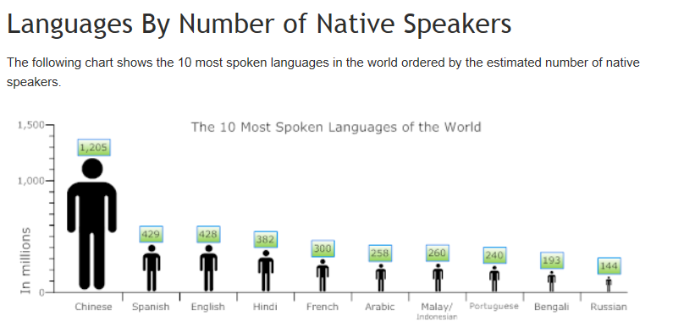
Spanish is the 2nd most popular first language (language you first spoke)in the world!

Slide 5
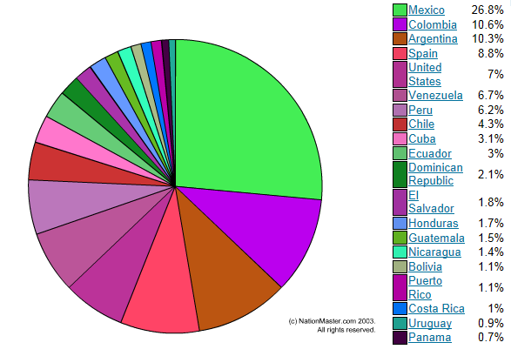
Where do Spanish-speaking people live?
5 countries with largest amount.
Mexico
Colombia
U.S.A
Argentina
Spain

Slide 6





2050
132.8 million
The projected Hispanic population of the United States on July 1, 2050. According to this projection, Hispanics will constitute 30 percent of the nation's population by that date.

Slide 7
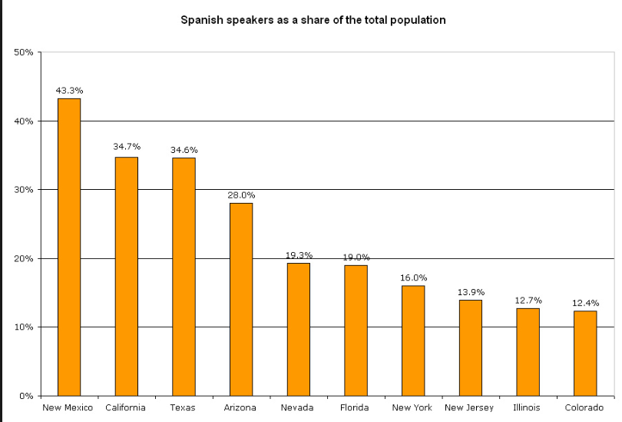
Where do Spanish-speakers live in the United States?

Slide 8


Slide 9
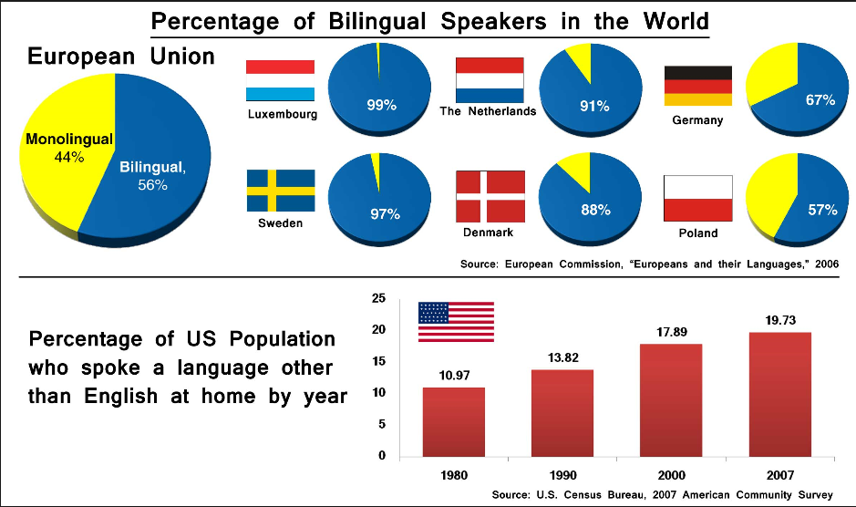
*Only 20% of Americans speak a second language! Compare that with 56% of Europeans who speak a second language! We can improve!

Slide 10

What’s in it for ME?
According to Careerbuilder.com, the following industries will be looking for Spanish-speaking employees in the 21st century:
*Healthcare
*Social Services
*Banks and Mortgage companies
*Education
*Sales

Slide 11
What’s in it for ME? - continued
*Many companies will pay higher salaries to bilingual employees than employees who only speak one language.
*Many job positions, especially in the future, will only be open to bilingual applicants!

Slide 12



It’s FUN to know Spanish???
*Many movies, television shows, and songs on the radio contain Spanish lines or are in Spanish.
* Speaking Spanish will help you enjoy them!

Slide 13

It’s FUN to know Spanish? -continued
*Learning Spanish will allow you to be able to experience new cultural traditions and celebrations!
* Speaking Spanish will facilitate making friends from around the world!

Slide 14



It’s FUN to know Spanish? -continued
*Speaking Spanish will be very helpful when you’re ready to travel!

Slide 15

But how long will it take me?
The average student takes 600 classroom hours to learn Spanish. That’s around 3-5 years.
That may seem like a long time, but Spanish is actually classified as an “easy” language to learn.
A typical “hard-to-learn” rated language like Chinese takes up to 2,200 classroom hours!
So, you’ve got a really great chance of becoming fluent in Spanish if you make the effort!

Slide 16
So, get started!

Slide 17
Discussion Questions:
*What would you say to someone who says “Why doesn’t everyone just speak English?”
*What is challenging about learning a foreign language?
*Are there any careers you think will not require someone to be bilingual?

