Slide 1
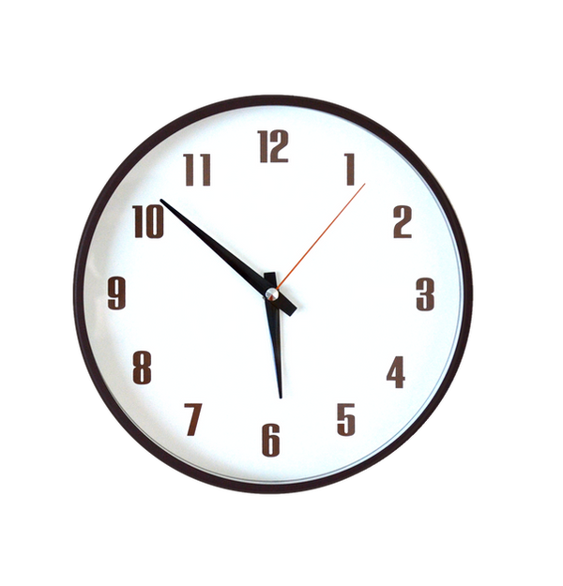
¿QuÉ Hora Es?
Telling Time in Spanish
This Photo by Unknown Author is licensed under CC BY

Slide 2
The Basics
Use ”Es la…” when referring to "one o'clock" and use ”Son las” when referring to all other hours.
Es la una. (It's one o'clock.)
Son las dos. (It's two o'clock.)

Slide 3
Minutos 0-30
Minutes can be added to the hour using the word y (and) up to 30.
Es la una y cinco. It's 1:05.
Son las tres y diez. It's 3:10.

Slide 4
Half + Quarter Past
You can also use the words media (half) and cuarto (quarter).
Es la una y media. It's 1:30. (It’s half past 1.)
Son las dos y cuarto. It's 2:15. (It’s a quarter past 2.)

Slide 5
Minutos 31-59
Minutes at 31 and beyond will use the MENOS method (telling how many minutes until the next hour.
STEPS:
1. Go up a hour
2. Add menos
3. Tack on # of minutes it takes to next hour
Ejemplo: 4:50
Son las cinco menos diez.

Slide 6
Morning, Noon and Night
To differentiate between a.m. and p.m. use the expressions de la mañana, de la tarde and de la noche.
Son las dos de la mañana. It's two in the morning.
Son las dos de la tarde. It's two in the afternoon.
Son las diez de la noche. It's ten in the evening.

Slide 7
Specific Times
Use “en punto” after the time to say “on the dot/exactly”.
Son las dos en punto. (It’s exactly 2./It’s 2 on the dot.)
To specifically say it’s midnight or noon use:
Es mediodía. It’s noon. (It’s half way through the day.)
Es medianoche. It’s midnight. (It’s half way through the night.)

