Slide 1
Numbers 1-31 and Writing Dates
https://www.youtube.com/watch?v=qJ93x5PMMko

Slide 2
Numbers/Números
0-15 memorize
10, 20, 30 →100 memorize (tens numbers)
16-19, 21-29: may write as 1 word or two
Ex: veinte y seis (26) (tens number “y” ones number)
Veintiséis (26) (must remember accent marks)
At 31 and beyond you MUST WRITE IT THE THREE WORD WAY:
Treinta y uno (31)

Slide 3
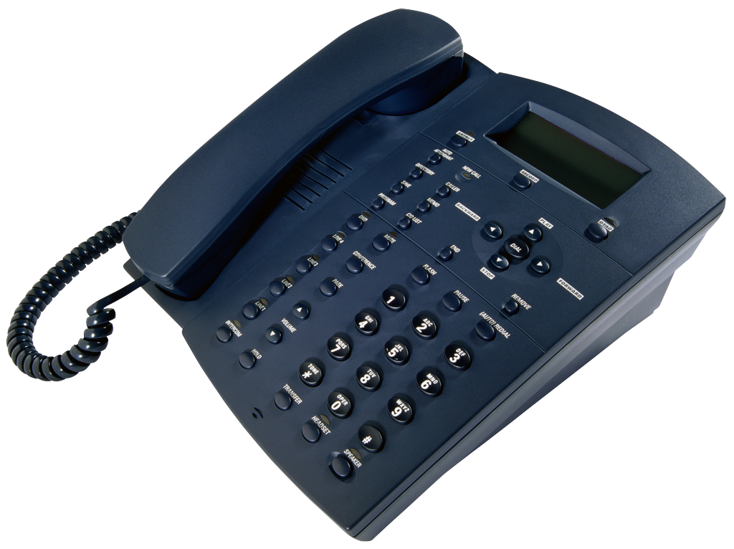
Asking for Phone Numbers
Q1: ¿Cuál es tu teléfono?
What is your phone number?
A1: Mi telefono es 725-1201.
My phone number is 725-1201.

Slide 4
Dates/Fechas
*Days of the week and months are NEVER capitalized unless they are at the beginning of a sentence.
Hoy es lunes.
Es diciembre.
*The Spanish calendar runs from Monday-Sunday: lunes →domingo
*Dates are written the opposite of English:
10/17 (US) ----October 17th
17/10 (US) ----el diez y siete de octubre

Slide 5
Practice/Practica
Practice turning the following English dates into Spanish.
Ex: 8/17: 17/8---Es el diez y siete de agosto.
12/24 __________________________________
3/13___________________________________
5/5____________________________________

