Slide 1
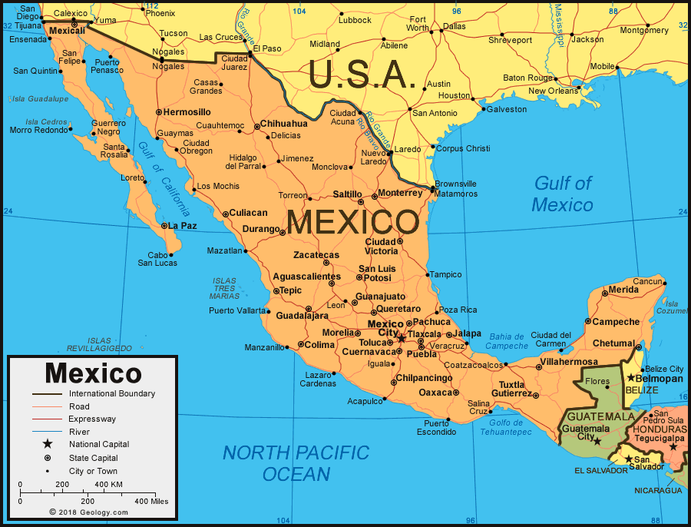
KEY FACTS: México
Directions: Por favor, fill in your guided notes as we discuss the following aspects of México!

Slide 2
Offical Name:
The United Mexican States
(Estados Unidos Mexicanos)

Slide 3
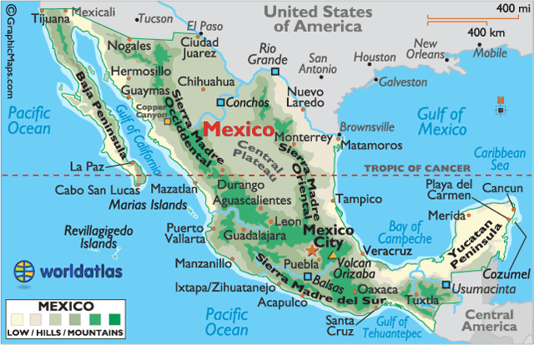
Geography:
Mexico has two areas that are surrounded by water on three sides. They are the BAJA and YUCATAN peninsulas.
What other peninsulas do you know?
Mexico is located in Central America and its capital is Mexico City (or Mexico D. F).
Neighbors: The United States, Belize, and Guatemala.
Links two Americas: North America and Central America
Mountains cover much of Mexico and some of the mountainous regions are rich in silver and copper.
Located partway between the Artic circle (north pole) and the equator.

Slide 4
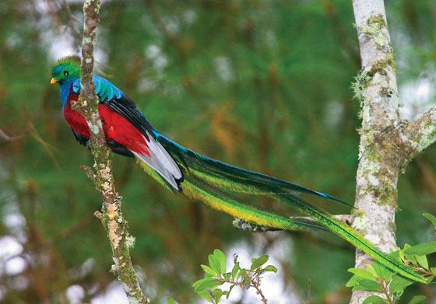
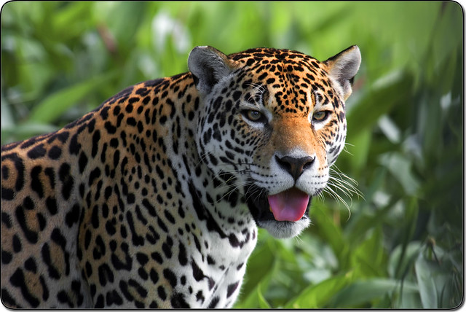
Nature:
Mexico has more species of plants & animals than most nations on Earth because animals seek refuge from intense heat and extreme cold there.
There are plants and animals from the desert , the tropics, the oceans, and elusive creatures like the quetzal birds and the jaguar.

Slide 5
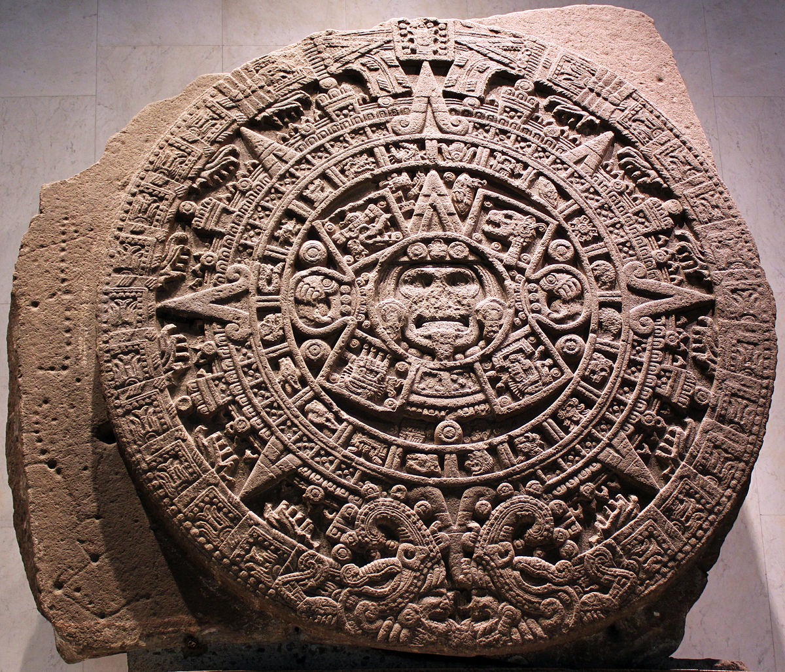
History:
Around 1200 B.C. , the first society of Mexico emerged: the Olmecs.
They were followed by the May, the Toltec, and the Aztecs.
The ancient societies created art and built great cities and huge pyramids, some of which are still standing today.
The ancients even studied the stars and planets to determine when to plant crops and hold ceremonies.

Slide 6
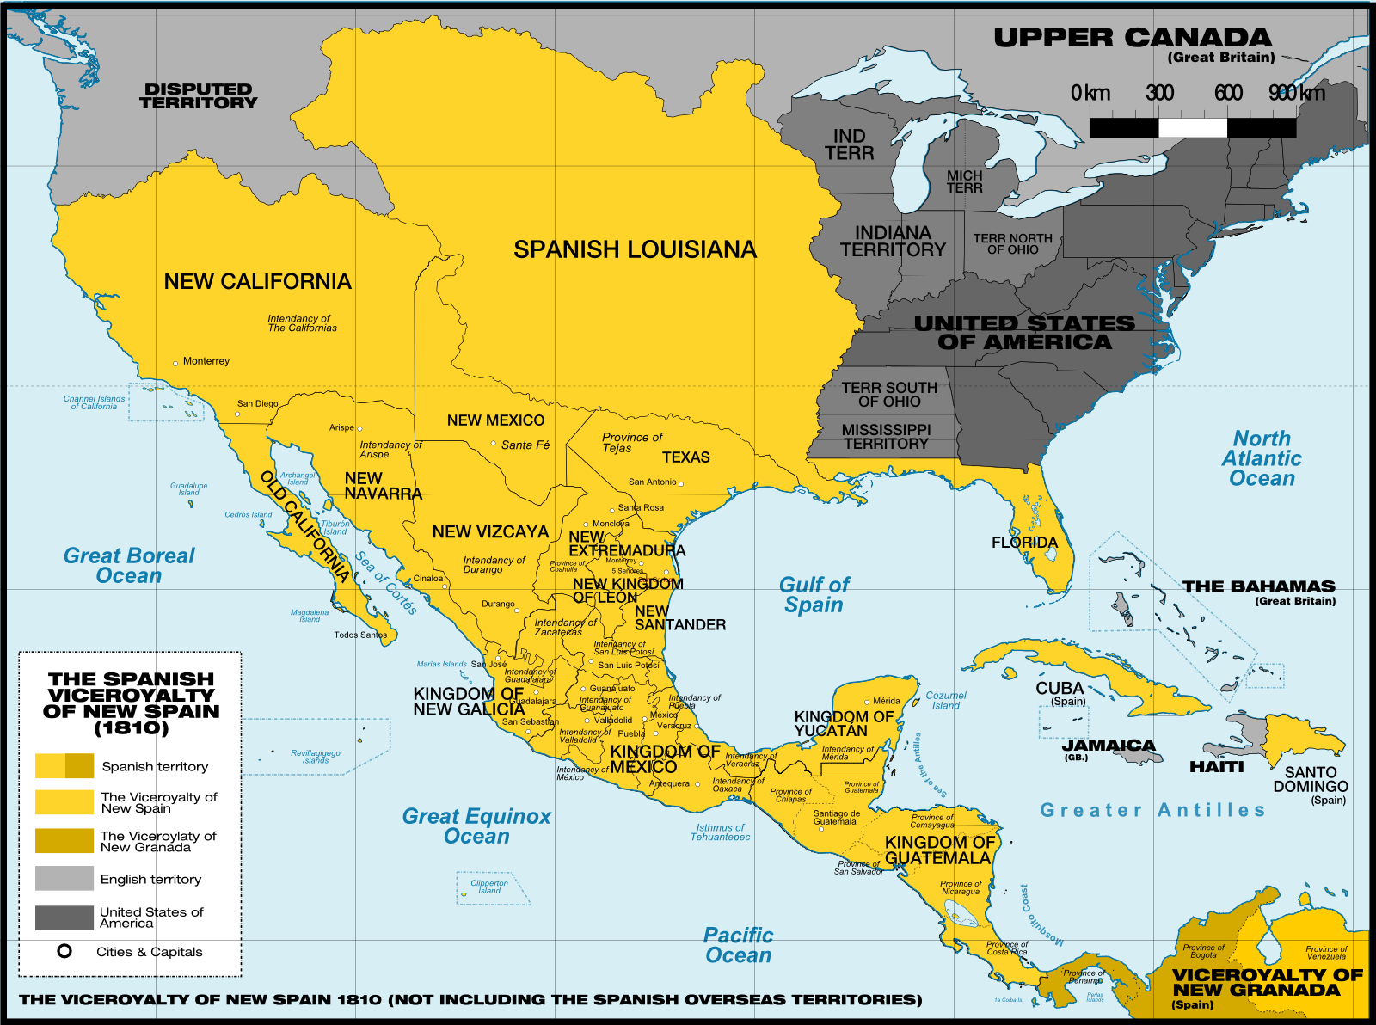
History Continued:
Early 1500s: The Spanish arrived in Mexico and brought smallpox and other diseases, which caused the Aztecs to get sick.
The Spainards (people from Spain) seized and destroyed the Aztec capital: Tenochitan
The Spaniards ruled Mexico until 1821.

Slide 7
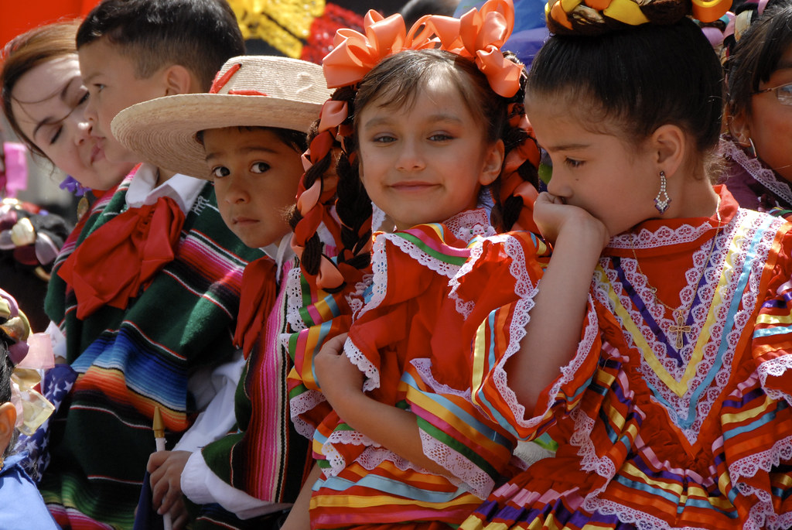
People & Culture
Mexico is a product of a rich Indian heritage, three centuries of Spanish rule, and a shared border with the world’s richest country: The United States
Today, most Mexicans are mestizo, which means they have a mix of Indian and Spanish blood (or ancestors).
Home to many great artists throughout history. Muralists, painters, sculptors, photographers, etc.

Slide 8
Form of government
Republic of Federated States
What does that mean? A federal republic is a federation of states with a republican form of government.^{[1]} At its core, the literal meaning of the word republic when used to reference a form of government means: "a country that is governed by elected representatives and by an elected leader (such as a president) rather than by a king or queen".
dictionary.com

Slide 9
Population
106,202,903 people
(Ciento seis millones, dos cientos dos mil, novecientos tres personas)

Slide 10
Offical Language:
Español

Slide 11
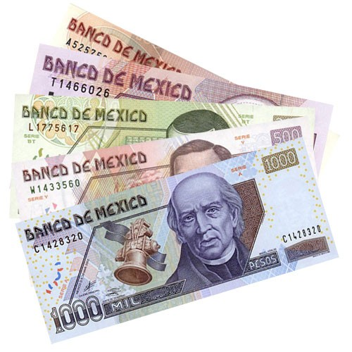
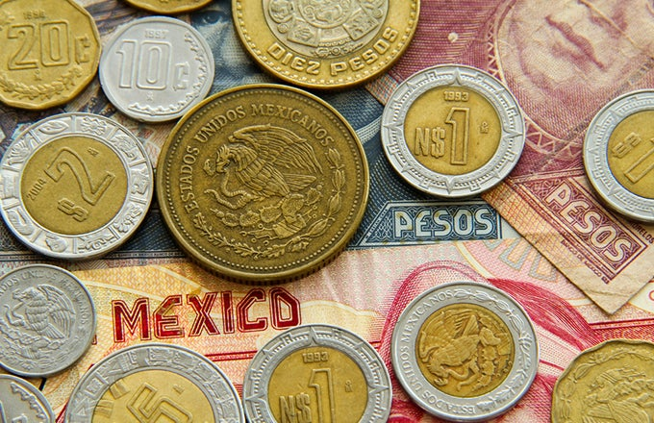
Money (dinero)
Mexican Peso

Slide 12
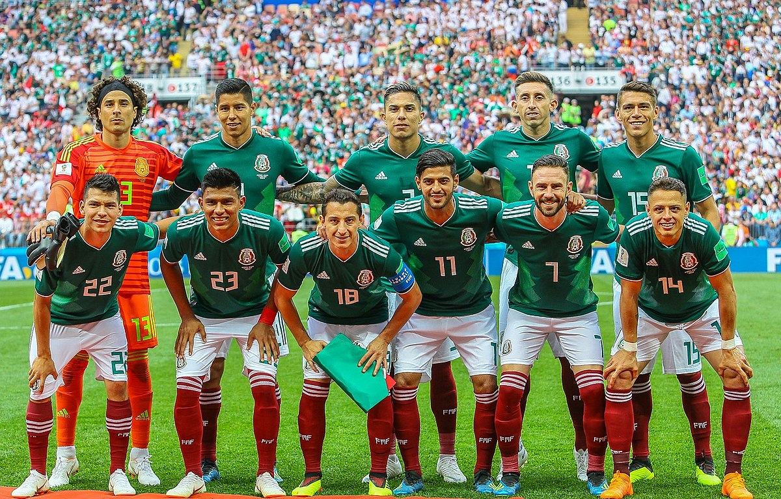
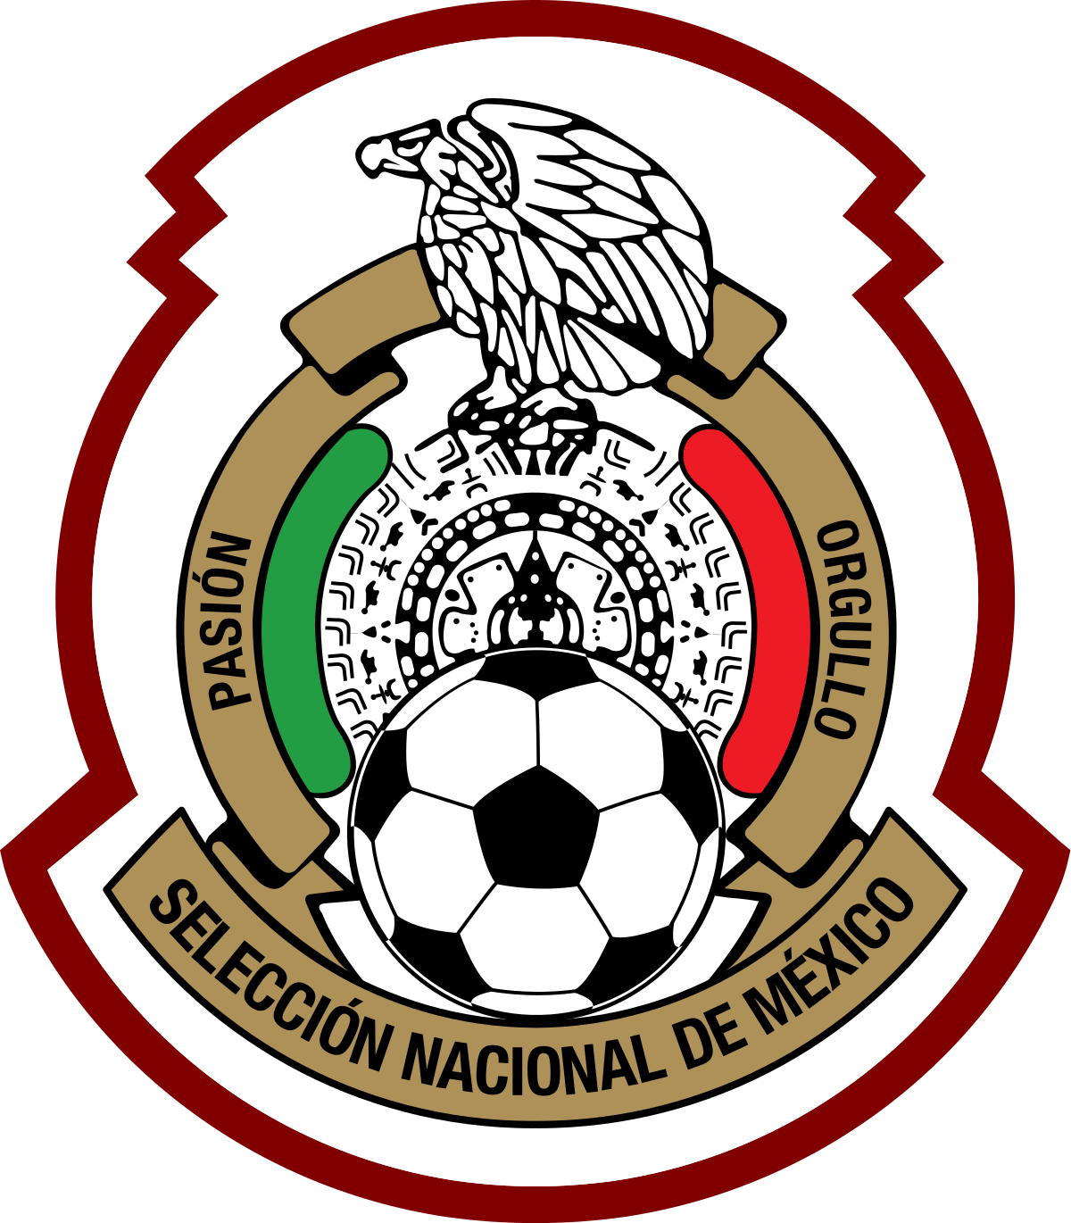
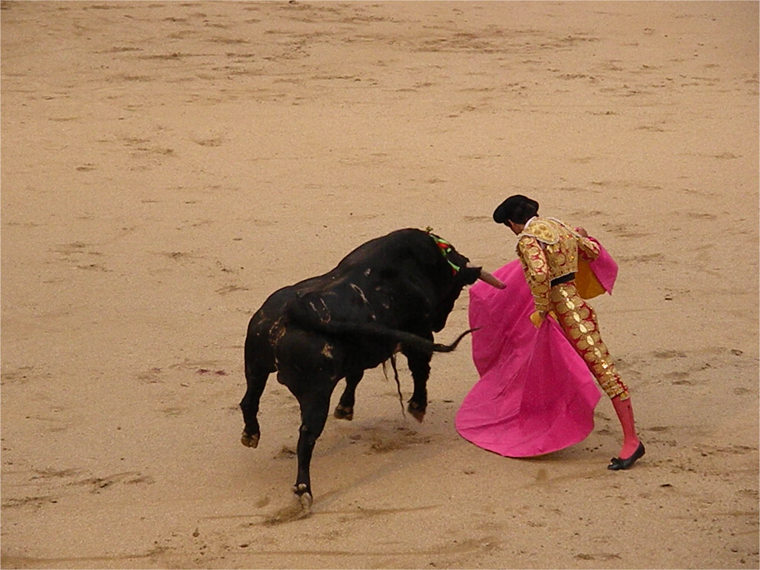
Major Sports:
Soccer and Bullfighting

