Slide 1
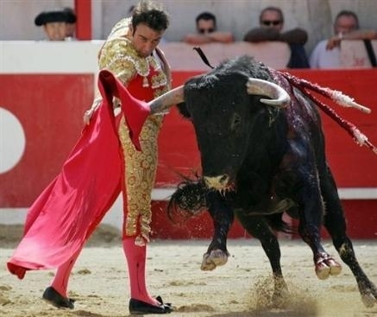
BULLFIGHTING NOTES

Slide 2
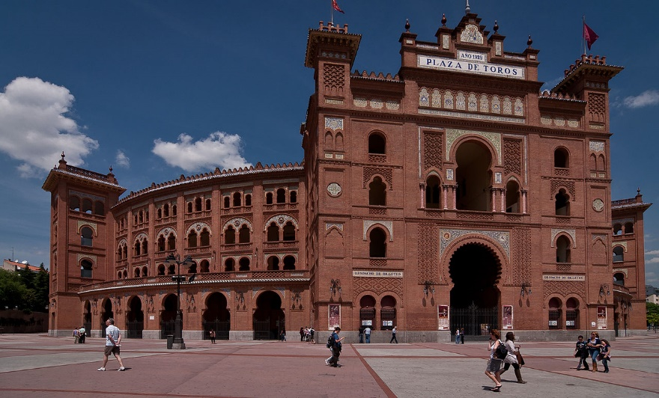
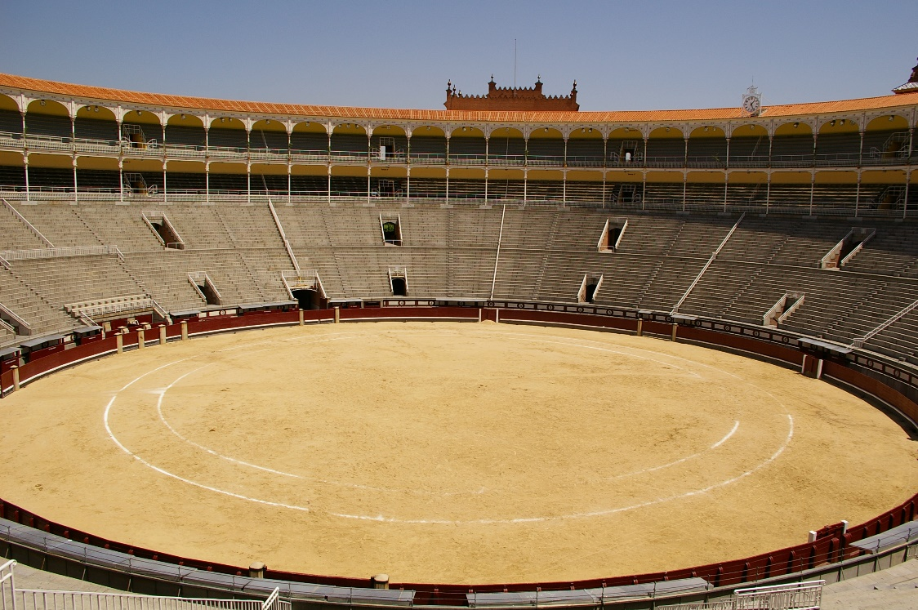
It’s a sport!
Bullfighting is an official sport in both México and España (Spain).
In Espana, bullfighting takes place in “la plaza de toros”
Toro: Bull
The arena is circular

Slide 3
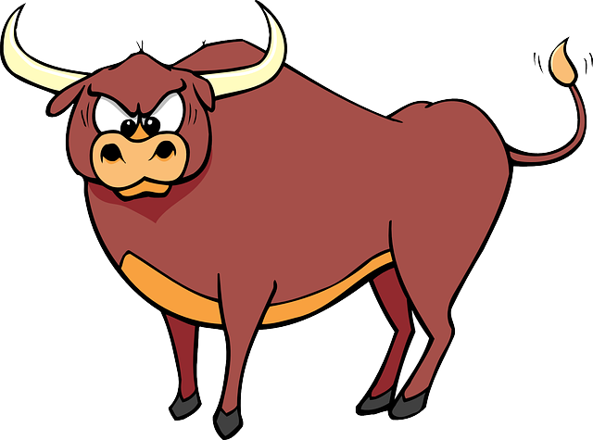
ACTS OF A BULLFIGHT
There are 3 “acts” (rounds) in a bullfight

Slide 4
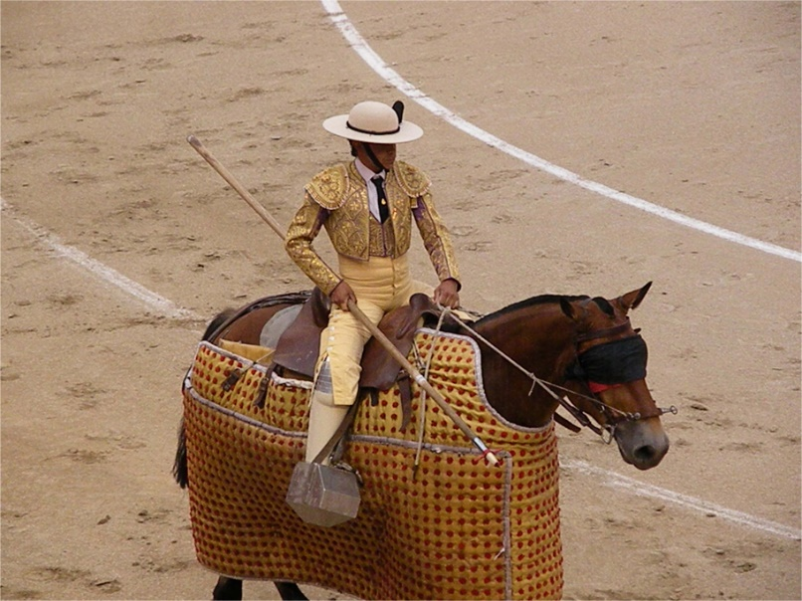
act 1: EL PICADOR
El picador: A man on an armored horse with a long spear. He tries to stab and weaken the bull.

Slide 5
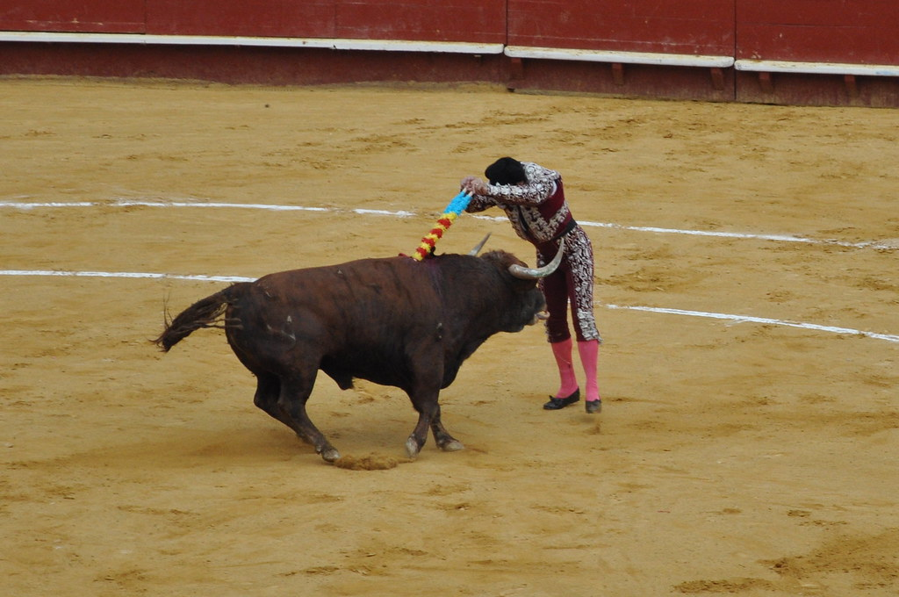
ACT 2: los banderilleros
Men on foot carrying “banderillas” (barbed small Spears with ribbons). In order to stab the bull, these men try to break the bull’s neck so it cannot lift it.

Slide 6
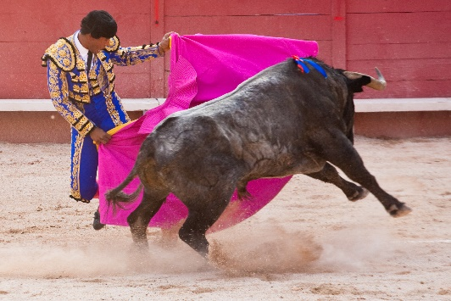
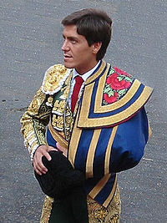
Act 3: la muerte (death)
The Matador: the famous athlete, comes out wearing the “traje de luces” (suit of lights). It’s called this because it’s bright, flashy and colorful.
The matador use skill/training, sword, red/pink cape. He tries to kill the bull by stabbing it through the neck/shoulder área in order to reach the heart.

Slide 7
Stadium information:
All stadiums are outdoor. For this reason, ticket prices depend on some factors :
2 options for tickets: SOL or SOMBRA
SOL (sun) tickets: Cheaper because you are sitting in the sun and it’s hotter. Sun may make it hard to see.
SOMBRA (shade) tickets: More expensive because they’re cooler and there is no glare from the sun.

Slide 8
Other facts
Bullfighters salute the president when they first come in to the arena
In Madrid (capital of España) there is NO music that is played while the bullfight takes place
Bulls are brought ot the arena 24-48 hours before the bullfight
3 matadors draw from hat to determine what bull they fight

Slide 9
Some people rerfer to bullfighting as a “art form” and not a sport. They believe it is beautiful to see the matador “dance” with a wild bull (almost taming it). They believe this exchange and the passes of the cape make it look like a dance/art.

